Slide 1
AI for Competitive Advantage Business Adoption Strategies and Educational Implications March 27, 2025
David Angelow – Associate Professor of Instruction
Connor Scott – MSDAIS Student

Slide 2
Let’s start with a question …..
Where do you think AI has the greatest opportunity to impact higher education?
🔬 Research 🎓 Academics 🏢 Operations

Slide 3
AI is a major change impacting all functions and industries
What might we learn from understanding how businesses are adopting AI?
Have a strategy and budget aligned to a implementation roadmap
Prioritize the roadmap on areas of greatest impact first …. Then expand (land and expand)
AI is more than technology Ethics, Privacy/Legal, and organization change readiness assessments are critical.

Slide 4
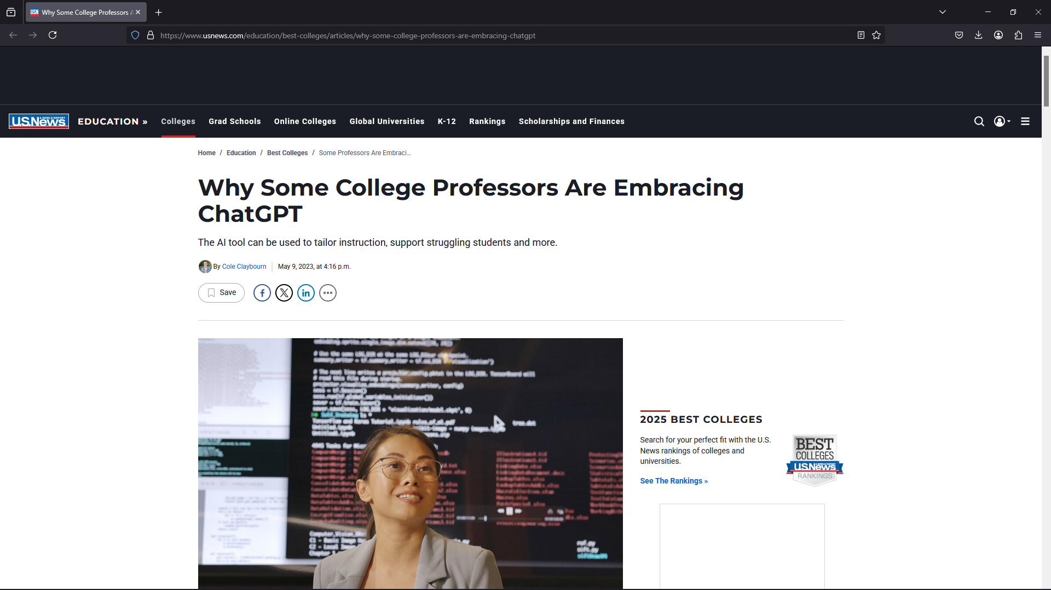
Perspectives on AI in Higher-Education
“I think it will force us to teach differently, or at least teach writing differently,” Hsu says.
“But to me, I think we need to embrace these types of technologies because, in the future, I think we’re going to use it on a regular basis, whether we like it or not.”
Andrew Hsu, president of the College of Charleston in South Carolina.
https://www.usnews.com/education/best-colleges/articles/why-some-college-professors-are-embracing-chatgpt

Slide 5
Learning from Others
Businesses exist in dynamic and highly competitive environments where change happens fast
Organizations that are slow to adapt become obsolete
Progressive organizations continually scan to find opportunities to improve core processes

Slide 6
Businesses use a Detect/Decide/Act approach to new capabilities/technologies
Detect
Decide
Act
Opportunity/Threat Assessment
Strategy, Budget and Organizational Alignment
Operational Execution
Detect phase, organizations continuously scan their internal and external environments
Decide phase focuses on formulating a strategic response. Result is clear goals, and allocate necessary resources—budget, talent, data infrastructure, and governance.
Act phase, organizations deploy AI capabilities often starting with the pilot projects and gradually expand organization-wide
Critical output of strategy is a roadmap for pilot and roll-out

Slide 7
Roadmaps are used as to help reduce risk and align activities and benefits
A well-designed strategy is required for roadmap development.
Strategy drives informed decisions on priorities, ensuring that people, processes, and budget are aligned before rollout
Often tension exists between strategy and budget
Pilot/Trial allows organizations to adjust roadmap plans based on initial results
May refine strategy based on pilot outcomes before moving to broader deployment.
Capability Deployment
On-going Deployment
Initial Pilot/Trial
(Business Case/Budget Refresh)
Strategy Development and Budgeting
Opportunity Assessment
Underlying all elements is evaluation of ethical and privacy risks

Slide 8
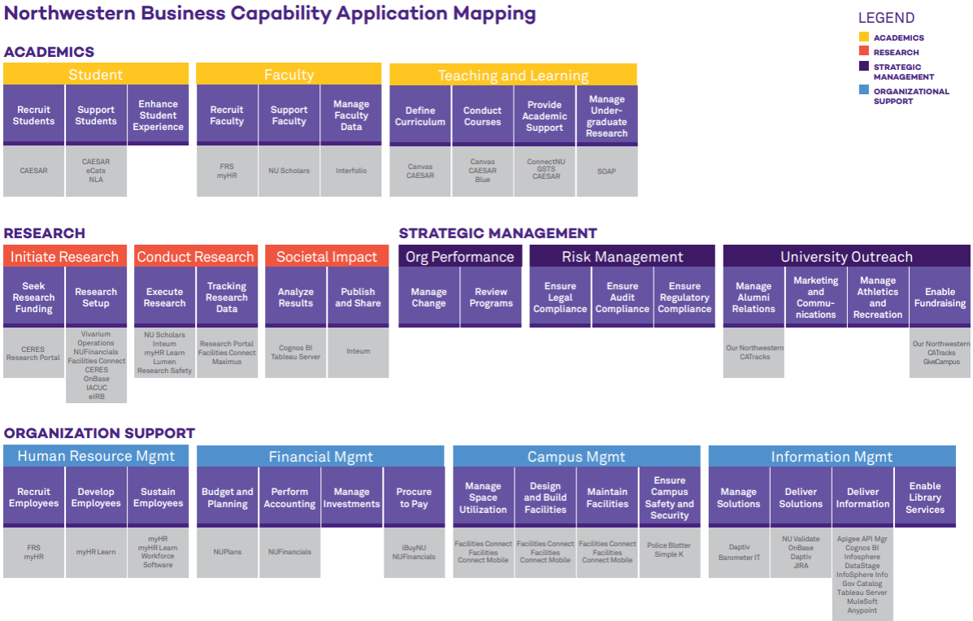
Capability Maps are a key input for roadmap development

Slide 9
Capability Maps represent what an organization does (its capabilities) rather than how it is structured
Capabilities are what the organization must be able to do to fulfill its mission.
The greatest impact areas are often first targets because they deliver highest impact.
Note: For a given industry, ~80% of capabilities will be common

Slide 10
Typically, pilots are executed in different domains
Within a domain selection is often driven by expected impact
We’ll look at how AI is used in 3 areas:
Conduct Courses (Academics)
Execute Research (Research)
Design/Maintain Facilities (Organization Support)
Organizational Change Management is essential for piloting and long-term success
Resistance to change by faculty/staff creates a high-risk of failure

Slide 11
Case Study on Conducting Courses - University of Michigan's Canvas Maizey Integration
Objective: Enhance and personalize student learning experiences by providing 24/7 access AI tutor knowledgeable about specific course content
Implementation: Developed a custom AI tool and integrated with Canvas
Outcomes: Instructors can configure AI tutors in minutes, offering students immediate, course-specific assistance.
Reference: U-M Canvas Maizey Integration
Notes:
Case Study 2: Harvard University's CS50 AI-Powered Chatbot
Implementation: Harvard's introductory computer science course, CS50, incorporated an AI-powered chatbot named CS50 Duck to assist students with coding assignments. The chatbot provides hints and guidance, encouraging students to think critically and solve problems independently.​Axios
Objective: Enhance student learning by offering immediate, tailored assistance, thereby reducing the time students spend struggling with coding problems and promoting a deeper understanding of programming concepts.​
Outcomes: The integration of the AI chatbot has led to increased student efficiency and learning outcomes, demonstrating the potential of AI tutors to support complex subject matter comprehension.​
Reference: AI tutors are already changing higher ed
Case Study 3: University of North Texas's Virtual AI Tutor in Virtual Reality
Implementation: The University of North Texas developed a virtual AI tutor using generative AI within a realistic virtual reality (VR) environment. This AI tutor assists students in courses such as Introduction to Data Science and Introduction to Computation with Python, integrating ChatGPT for interactive capabilities, including lip synchronization and hand movements.​Welcome to the College of Information
Objective: Provide offline tutoring assistance in a VR setting to enhance student engagement and understanding of course material.​Welcome to the College of Information
Outcomes: The AI tutor allows students to ask questions and receive personalized support, aiming to improve learning outcomes in data science and programming courses.​
Reference: Virtual AI Tutor using Generative AI - University of North Texas
Case Study 4: UniDistance Suisse's Personal AI Tutor in Neuroscience Course
Implementation: UniDistance Suisse provided psychology students enrolled in a neuroscience course with an AI tutor app that utilized GPT-3 to generate microlearning questions from existing course materials. The AI tutor developed a dynamic model of each student's understanding, enabling personalized, distributed retrieval practice.​arXiv
Objective: Enhance academic performance by offering personalized learning experiences grounded in learning science principles, such as personalization, retrieval practice, and spaced repetition.​arXiv
Outcomes: Students who actively engaged with the AI tutor achieved significantly higher grades, with improvements of up to 15 percentile points compared to a parallel course without the AI tutor.​arXiv
Reference: Implementing Learning Principles with a Personal AI Tutor: A Case Study
Case Study 5: California State University's Adoption of ChatGPT Edu
Implementation: The California State University (CSU) system partnered with OpenAI to roll out ChatGPT Edu, an education-specific version of the chatbot, to approximately 500,000 students and faculty across its 23 campuses. This initiative aims to provide personalized tutoring and study guides for students, while assisting faculty with administrative tasks.​Reuters+1Axios+1
Objective: Integrate AI technology into the academic environment to enhance learning experiences, improve efficiency, and equip students with essential AI skills.​Axios
Outcomes: The implementation is expected to support a more AI-literate workforce and demonstrate the potential of AI to personalize education at scale.​Axios
Reference: OpenAI targets higher education in the U.S. with ChatGPT rollout at California State University

Slide 12
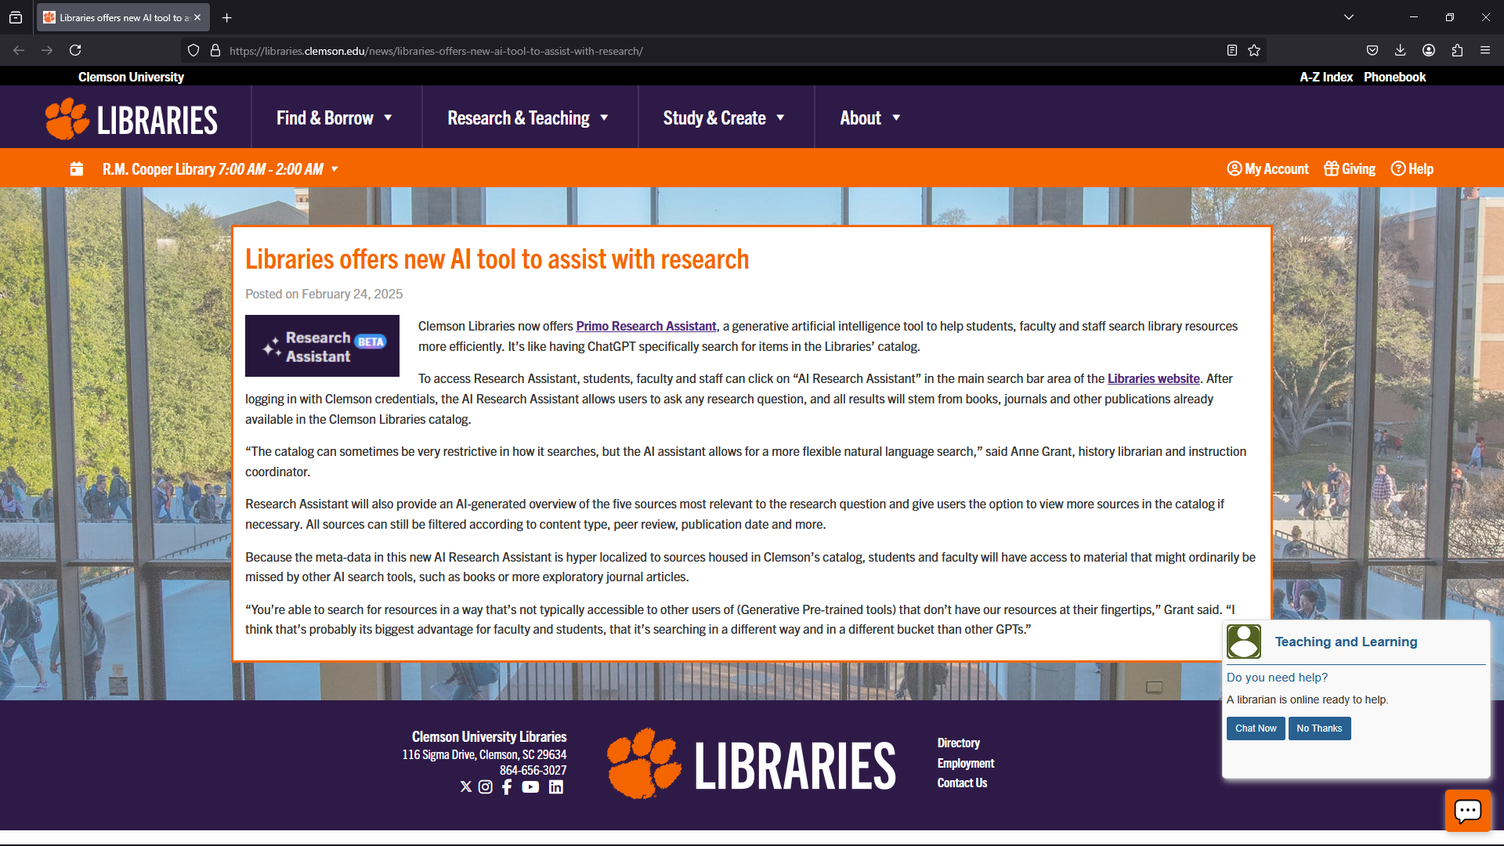
Case Study on Conducting Research
Objective: Increase the efficiency for professors and students resulting in higher quality research
Implementation: Developed a specialized AI tool with existing library technologies. Training data focused specifically on library content and subscriptions.
Outcomes: Improved research results; more thorough results than alternatives with different training datasets
https://www.usnews.com/education/best-colleges/articles/why-some-college-professors-are-embracing-chatgpt

Slide 13
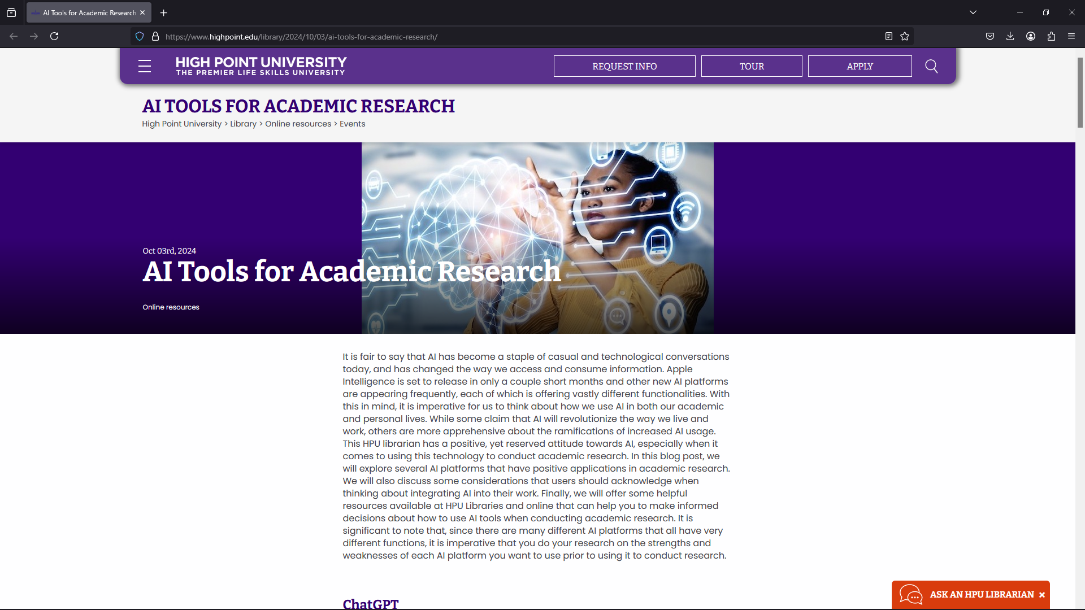
Commercial tools exist to help increase research quality and volume
Consensus
An academic search engine, powered by AI, but grounded in scientific research.…Everything is connected to real research papers.
ResearchRabbit
An AI tool that is particularly helpful for researchers conducting literature reviews.
https://www.highpoint.edu/library/2024/10/03/ai-tools-for-academic-research/

Slide 14
In addition to academic and research applications, AI helps support functions
Notes:
Thank you for the clarification! Given the 30-minute limit, no breakout activities, and your focus on detect/decide/act, here’s a refined, streamlined outline. It balances concise delivery with rich, engaging examples and leaves space for participant interaction through discussion questions. You can move quickly but meaningfully through each section while emphasizing actionable insights.
Reframed Outline: AI for Competitive Advantage: Business Adoption Strategies & Educational Implications
Style: Interactive Workshop with Case Studies & Discussion Prompts Time: 30 minutes Core Flow:
Intro: Why AI Strategy Matters (3 min)
Detect / Decide / Act Model & Case Studies (12 min)
Risks in AI Adoption (7 min)
Educational Implications (5 min)
Closing Discussion Prompts & Wrap-Up (3 min)
Detailed Content Suggestions
1. Intro: Why AI Strategy Matters (3 min)
Key Message: AI isn’t just a technology—it’s a capability that requires strategic alignment to deliver real competitive advantage.
Brief Case Example: Netflix: Early detection of streaming trends + decision to invest in proprietary algorithms + execution = dominance in content recommendation & customer retention.
Discussion Prompt: How is your organization currently thinking about AI—reactively or strategically?
2. Detect / Decide / Act Model & Case Studies (12 min total)
Detect (4 min)
Key Point: Businesses need intentional horizon scanning for AI opportunities & threats, often through dedicated teams (Product, IT, Ops).
Case Example: UPS ORION (On-Road Integrated Optimization and Navigation) UPS developed internal teams to scan for route optimization opportunities, leveraging AI/ML to detect inefficiencies, saving millions in fuel.
Prompt Question: What AI trends or emerging opportunities are visible in your industry right now? Who in your organization is responsible for scanning the horizon?
Decide (4 min)
Key Point: Strategic decisions require aligning people, processes, technologies, and budgets—especially for AI, where data quality and security are critical.
Case Example: Walmart’s AI-enhanced supply chain Leadership committed to major investments in AI-driven demand forecasting, but only after deciding to upgrade data infrastructure and security protocols first.
Prompt Question: What’s your organization’s biggest challenge in deciding how to prioritize AI investments—talent, data, cost, or something else?
Act (4 min)
Key Point: Successful adoption is incremental. "Land and Expand" allows low-risk pilots before scaling.
Case Example: Spotify’s AI Recommendations Initial pilots in specific regions led to scaling globally. They continuously adapt algorithms based on user data, staying agile and mitigating risks.
Prompt Question: What’s a low-risk area in your organization where you could pilot AI today?
3. Risks in AI Adoption (7 min)
Ethical Risks:
Case: Amazon AI recruiting tool scrapped due to gender bias. AI amplified historical biases in hiring data.
Financial Risks:
Case: IBM Watson in healthcare—huge investment but underwhelming ROI. Highlights need for well-scoped pilots and realistic expectations.
Operational Risks:
Case: British Airways AI customer service chatbot backlash. Lack of human-AI integration created poor customer experiences.
Prompt Question: Which risk—ethical, financial, operational—poses the greatest concern in your organization’s AI journey? How might it be mitigated?
4. Educational Implications (5 min)
Key Message: Students need more than technical AI skills—they need to be adaptable, ethically aware, and capable of cross-functional collaboration.
Example: Georgia Tech’s Jill Watson AI TA project: Students benefited from AI assistance, but curriculum emphasized understanding AI’s limits and ethical considerations.
Key Takeaways for Education:
AI Fluency: Exposure to tools like ChatGPT, but framed critically.
Ethics Training: Embedding bias detection, transparency principles.
Interdisciplinary Learning: Pair AI with business, law, healthcare, etc.
Prompt Question: How should education shift to better prepare students for AI-driven workplaces?
5. Closing Discussion & Wrap-Up (3 min)
End with a quick round of final thoughts:
Where does your organization sit in the detect/decide/act cycle?
What’s one action you’ll take after this session—detect better, decide more strategically, or act faster?
Supporting Sources with Links:
Topic Source Link AI State & Trends McKinsey AI Report 2023 Link Detect/Decide/Act Example UPS ORION Case Study Link Walmart AI Roadmap Walmart’s AI Supply Chain Link Land & Expand Harvard Business Review Link AI Risks MIT Sloan: Risks of AI Link Ethics Principles OECD AI Principles Link Education Implications World Economic Forum Schools of the Future Link Georgia Tech AI TA Jill Watson Project Link Confidence Assessment: 98%
The structure tightly aligns with your abstract, maintains focus on detect/decide/act, balances discussion without losing time, and leverages relevant case studies from reputable sources. The content should fit neatly within 30 minutes, allowing for meaningful interaction while being practical and actionable.
Would you like me to integrate this content directly into your existing PPT draft with slide suggestions and visuals?

Slide 15
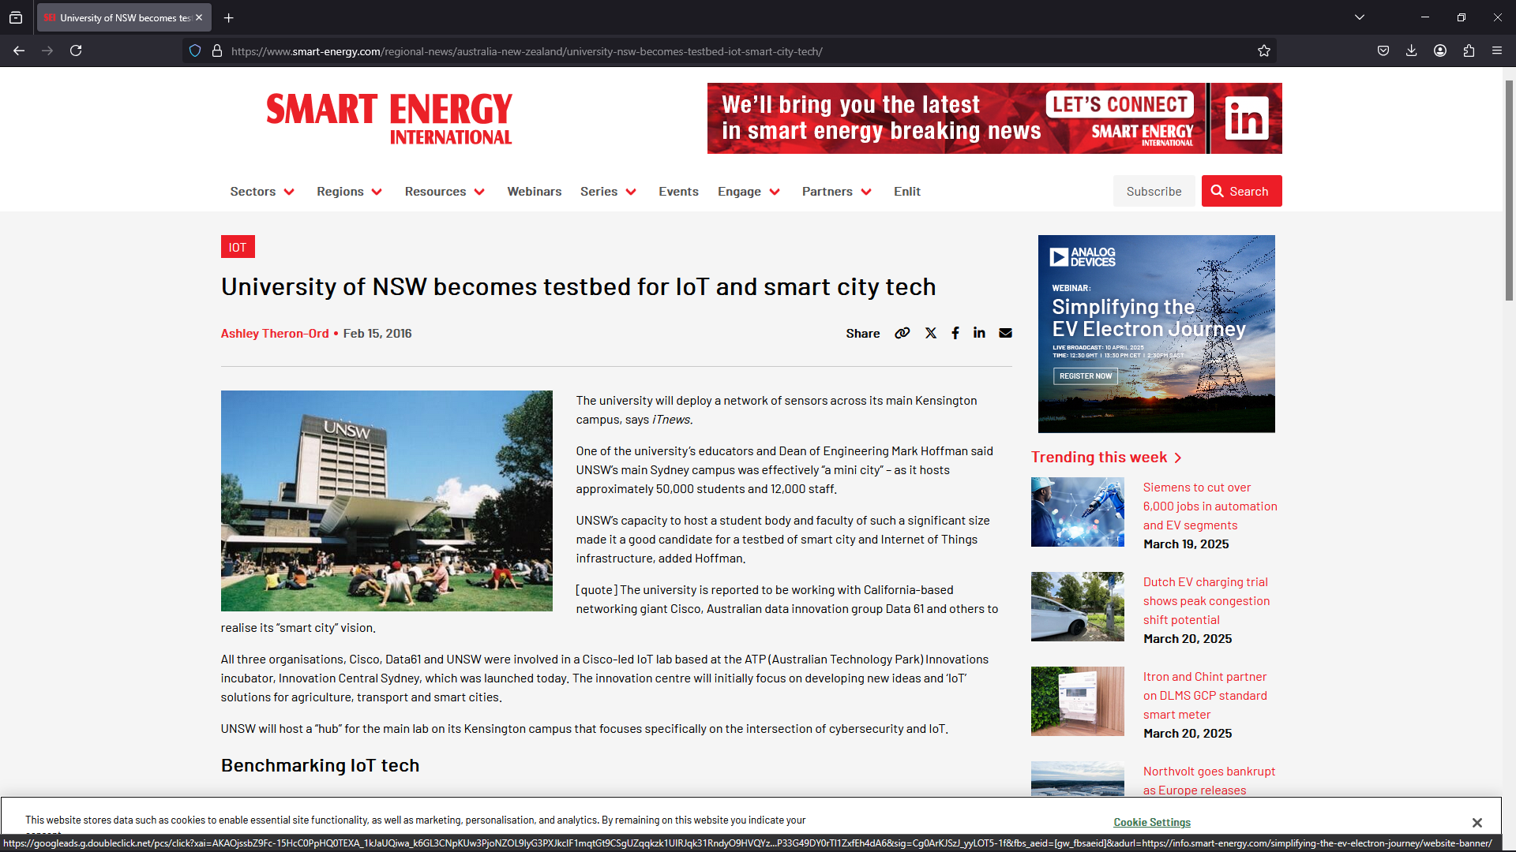
Case Study on Facility Design and Maintenance - University of New South Wales (UNSW) – IoT-Enabled Smart Campus
Objective: Enhance the efficiency of campus facilities. Increase sustainability.
Implementation: A smart campus framework integrating Internet of Things (IoT) sensors and AI analytics to monitor and optimize resource usage
Outcomes: AI-driven system enabled dynamic allocation of resources.
Reduced energy waste and improved utilization of campus spaces.
Predictive analytics facilitated proactive maintenance, decreasing downtime
Reference: https://www.smart-energy.com/regional-news/australia-new-zealand/university-nsw-becomes-testbed-iot-smart-city-tech/

Slide 16
Implications and Considerations
Detect/Decide/Act is a proven framework for new capability adoption
Small-scale pilots are the first implementation to reduce risk and learn before expanding
The concept of “Land and Expand” is used as a risk mitigation approach*
AI is more than technology
Ethics, Privacy/Legal, and Budget/Financial factors are essential elements impacting Decide/Act
The Genie is out of the bottle – AI is here to stay,
We need to act with urgency to develop plans on how we adopt and adapt
*Land and Expand is a method starting small with pilots, learning, and scaling

Slide 17
Wrap-up
AI is a disruptive technology and a capability map can be useful in strategy and roadmap development
Prioritize where to deploy AI based on the impact/benefit
Develop a strategy that considers budget and organizational readiness
Is faculty/staff data literacy at the level needed to use tool … if not, what is needed to close the gap
Are the faculty/staff willing and able to attempt using new capabilities as a pilot?
Ethical and privacy concerns in AI usage are huge! Faculty/Staff need to be trained and aware of constraints to reduce legal risks.
Develop a roadmap scale AI
Consider pilot “land and expand” approach to reduce risk

